Slide 1
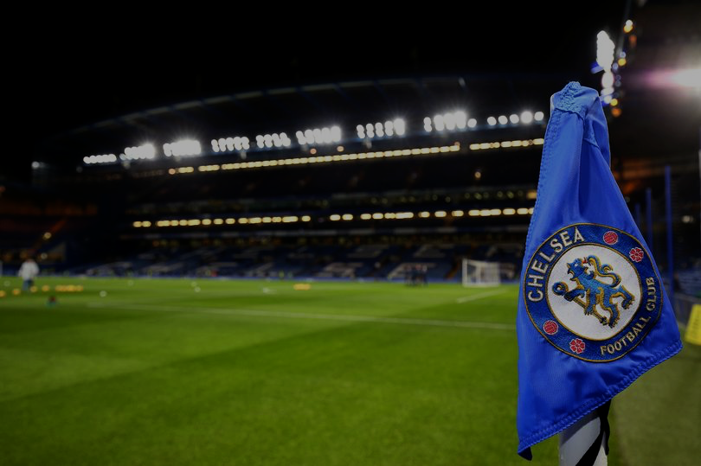
Chelsea Group Project
October 2022
David Andersson, Edd Webster, Leyla Abdul Kader, Lukas Schmid, Mattias Holmström, Paula Borst, Tim Solig, Yash Karle
Slides: https://docs.google.com/presentation/d/1rGntP2QkR1ubtB2pdVVz1Inf05eK7eVA2tUy7XggirE/edit?usp=sharing
Code:

Slide 2
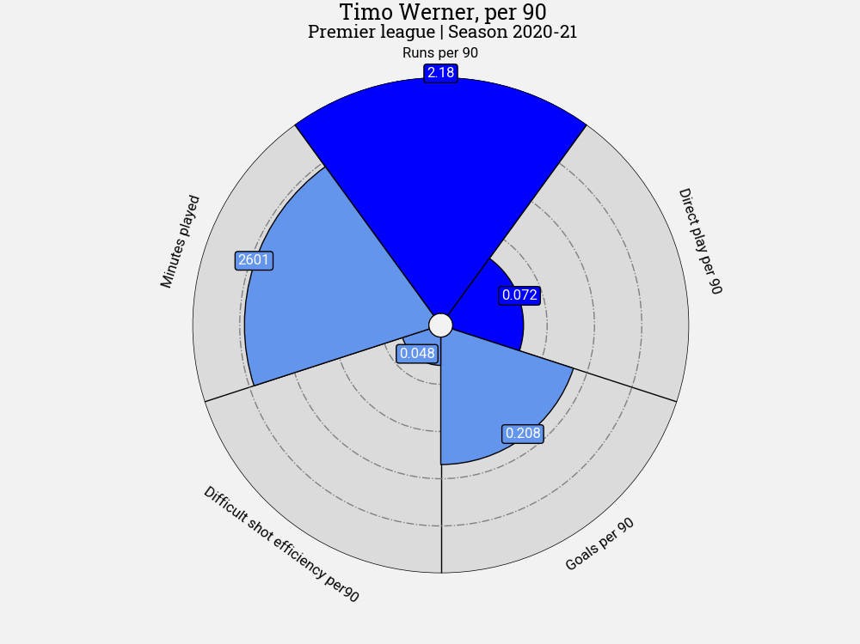
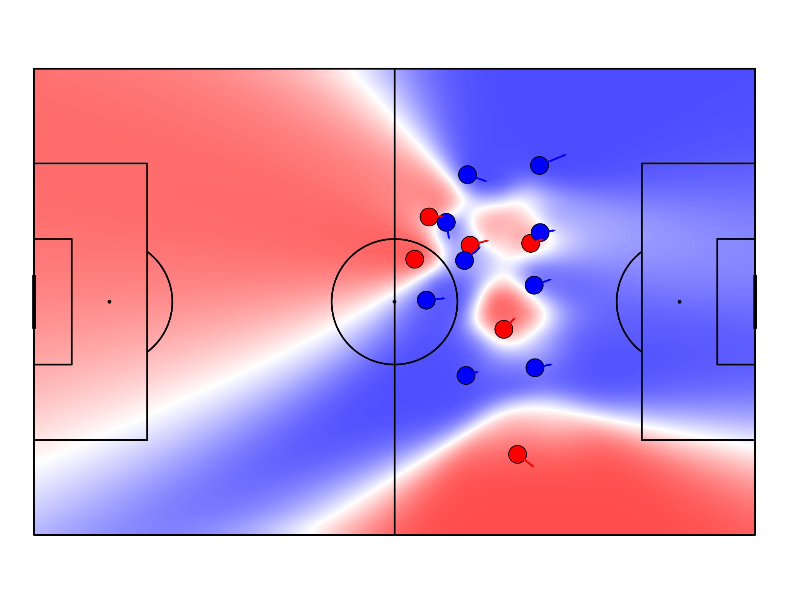
Contents
Introduction (slides 3-4)
Analytical Projects (3):
Club Performance (slides 5-9)
Set Pieces (slides 10-16)
Tracking Data Scouting (slides 17-24)
Conclusion (slide 25-26)
References (slide 27-28)

Slide 3
Introduction

Slide 4
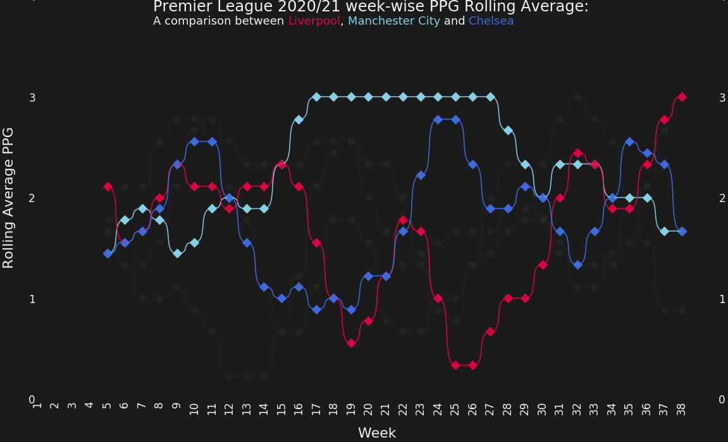
Introduction
End of 20-21 EPL season review and look forward at ways to improve for the 21-22 season
1
How will Chelsea bridge the gap to Man City & Liverpool?
How can Chelsea be unpredictable in the final 3rd and unlock low-block opponents?
How can Chelsea manage to put games to bed (2+ goals lead) and avoid high pressure situations at the end?
Lampard’s demise
Patchy again
2
3
Flying off the blocks
Tuchel takes over
UCL focus

Slide 5
Project 1: Club Performance
Through the evaluation of a prediction model

Slide 6
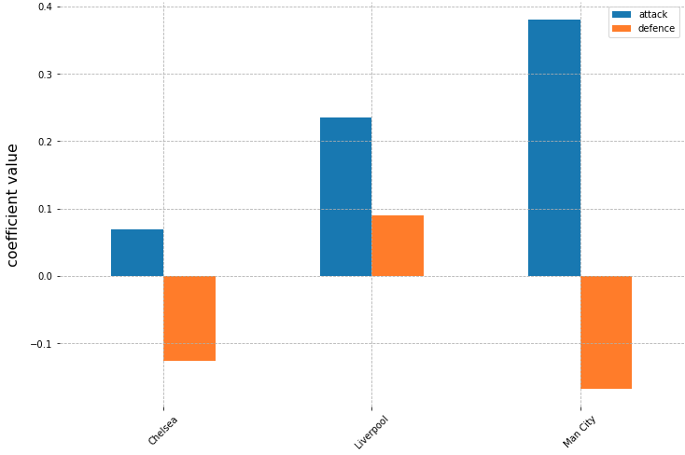
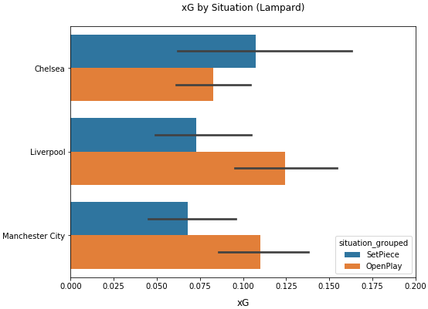
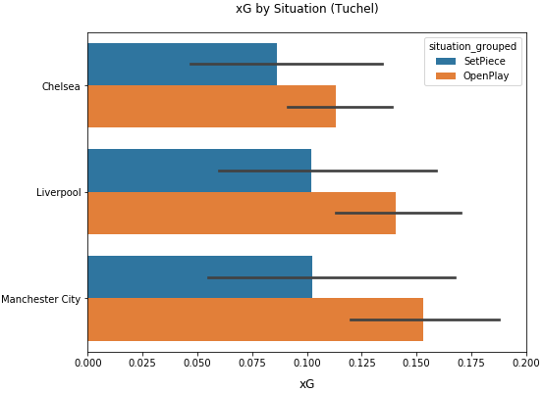
In search of marginal gains…
Narrowing down our focus on areas where there’s most potential value to be gained
Naïve first pass regression model to gauge offensive vs defensive shortcomings
Are the strikers being wasteful or do the numbers paint a different story?
Are Chelsea under Tuchel solid defensively or were they just lucky in keeping clean sheets?
How does the 1st half of the season compare with the 2nd half?
Can we spot any major shift in trends for xG avenues?
Are we already catching-up with City and Liverpool?

Slide 7
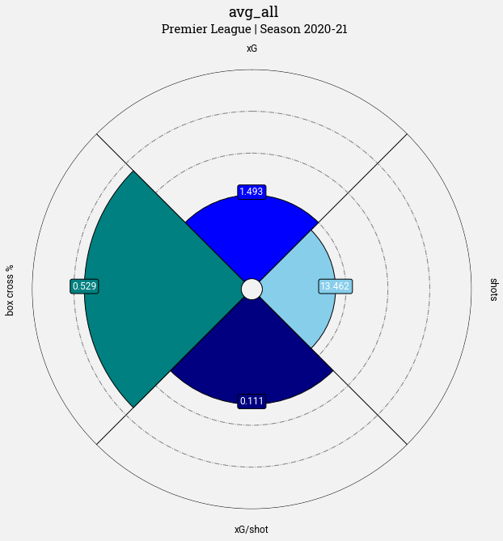
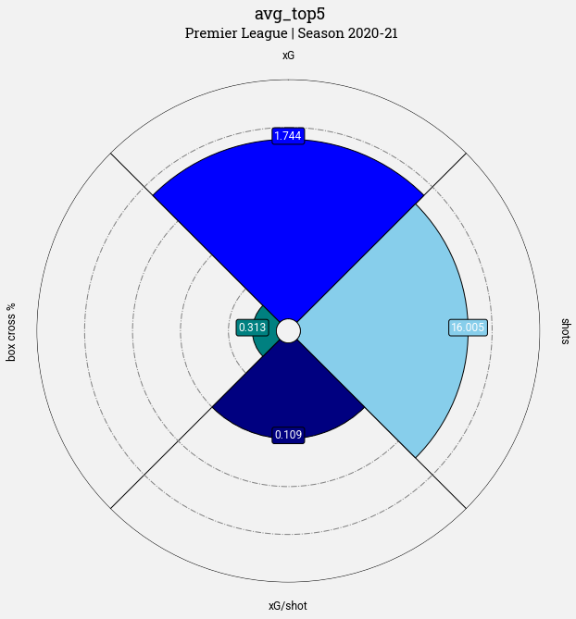
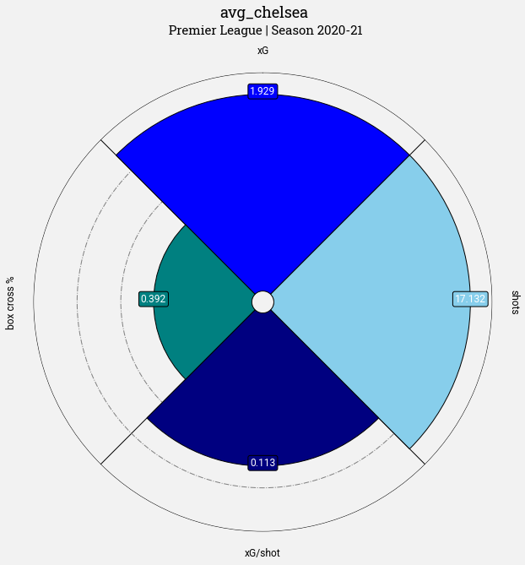
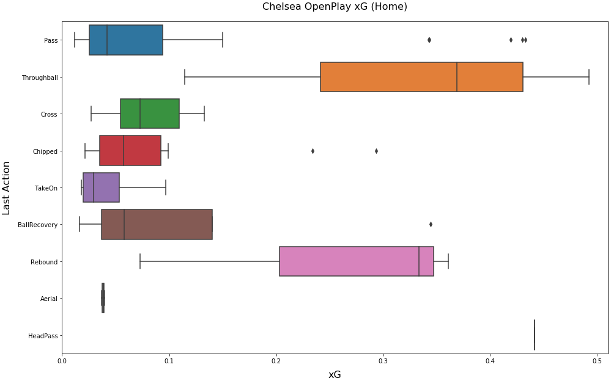
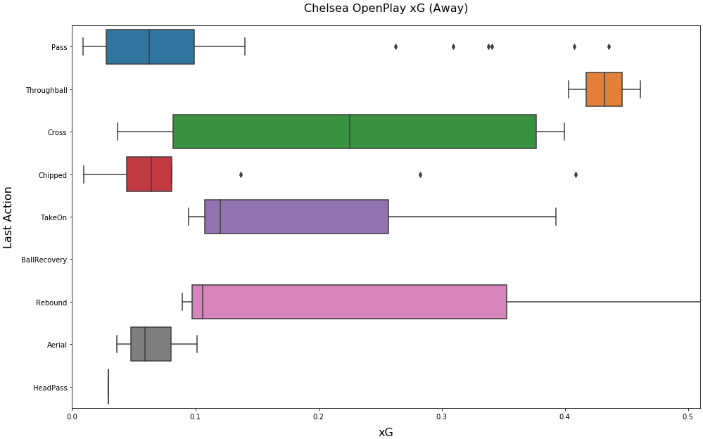
Chelsea’s attacking style under Tuchel
What are the key differentials when it comes to offensive team attributes?
Analysing team KPIs to identify specific areas for improvement and correlations
Box cross %
Shots
xG
xG/shot
Better understand open play chance creation; home vs away differences
This feeds into fine-tuning the recommendations of the tracking data scouting
“LastAction” : [Pass, ThroughBall, Cross, Chipped, TakeOn, BallRecovery, Rebound, Aerial, HeadPass] refer to the penultimate player action before leading to a shot

Slide 8
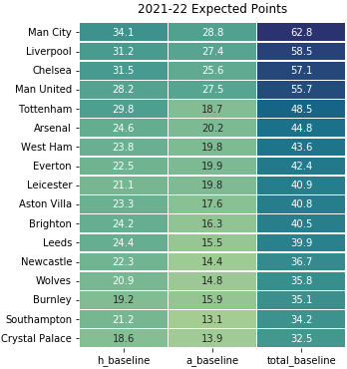
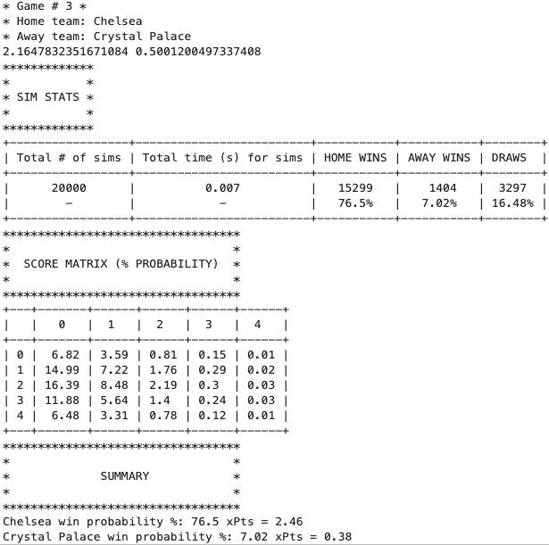
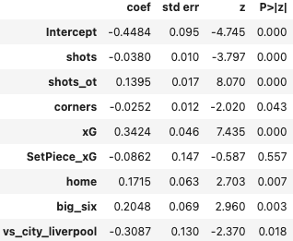
Building a performance-based league simulation model
Baseline Poisson regression model built and 21-22 season simulated using Monte Carlo Simulations (20,000 iterations)
Training data used from 19-20 season and predictions made based on performance metrics from the 20-21 season
Simulated for a 17-team league; leaving out the newly promoted teams owing to data limitations
“A top six team playing at home against a team other than City or Liverpool with more shots on target” scores the most

Slide 9
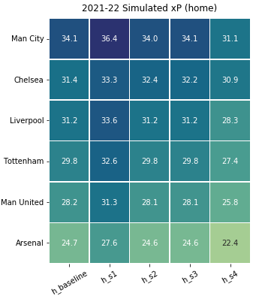
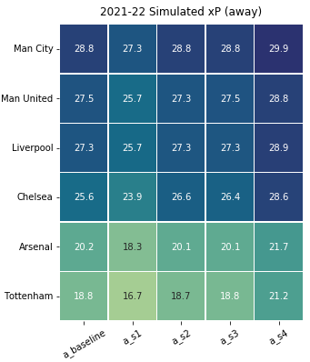
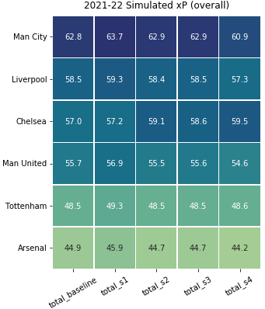
Simulate Alternative Scenarios to Determine Improvements to Chelsea’s Attacking Output
Determined by simulating “what-if” scenarios for both quantitative and qualitative features
Scaling up home team’s xG by 0.1% of stadium capacity in 1000s for all teams e.g. Chelsea playing at Stamford bridge (capacity 40k) expect to have +0.4xG added for their home matches;
Chelsea have a 10% increase in overall shots on target per match;
Chelsea have a 10% increase in xG per match against the teams outside of top six; and
All of the above 3 scenarios come true: results in 65%(+35%) chances of a top 2 finish

Slide 10
Project 2: Set Pieces
To investigate clubs strengths and weaknesses with free-kicks, corners and throw-ins

Slide 11
Chelsea scored 12 out of 58 goals in the 20/21 Premier League season from a set piece*
*A set piece is defined as a goal coming directly from a set piece or initiated from a dead-ball situation and later resulting in a goal from the subsequent actions.
Reference: whoscored.com/Regions/252/Tournaments/2/Seasons/8228/Stages/18685/TeamStatistics/England-Premier-League-2020-2021
Notes:
The importance of set pieces can be illustrated by this statistic of the 2020/2021 premier league- where set piece initiated plays made up around 20% of chelsea’s goals.
On average, set pieces can account for anything from 20-40% of all goals scored in a season

Slide 12
Objectives of this Set Pieces Analysis
Goals & Methods
Objectives:
Analyse set pieces; free-kicks, throw-ins and corners, and how they contributed to Chelsea’s success in the 2020/2021 season.
Identify possible weaknesses in the set pieces.
Compare Chelsea’s set piece performance (mainly focused on the offense) with the rest of the league, also focusing on the top 6, based on expected goal (xG) and expected threat (xT) values.
Did switching from Lampard to Tuchel mid-season have any impact for set-pieces?
Methods used:
Heatmaps to investigate possible trends in how set pieces are carried out.
Possession chains & their visualizations to isolate specific event chains that led to shots (whether successful or not).
Line graphs indicating Chelsea’s xG and xT performance per game week & average lines for the xGs of the top 6 and all teams in the league.
Possession chains with their calculated xT values.
Ranked list of Chelsea’s top players based on xG & xT values.
Notes:
Possession chains were filtered to the following:
Only chains with duration <25s
Only chains with a shot distance <30m
Notes:
Our objectives were to:
Analyse freekicks, corners and throw-ins based on xG and xT values
Identify possible weaknesses for each set piece
And investigate whether the management switch mid season had an impact on set pieces
We used heatmaps to analyse how set pieces were carried out,
Possession chains & their visualizations to isolate specific events and study them
We then graphed xG and xT values to compare chelsea’s performance with that of the rest of the league
And ranked chelsea’s players in accordance to these metrics

Slide 13
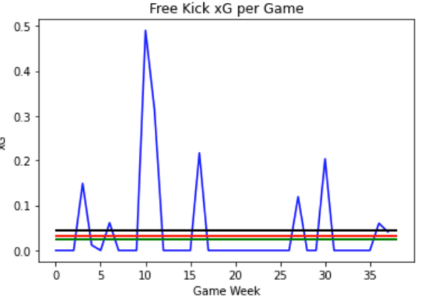
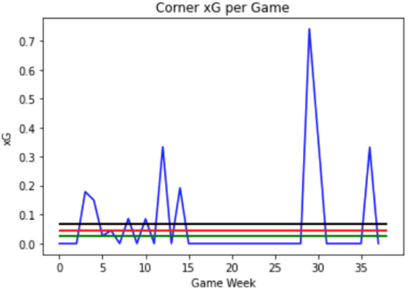
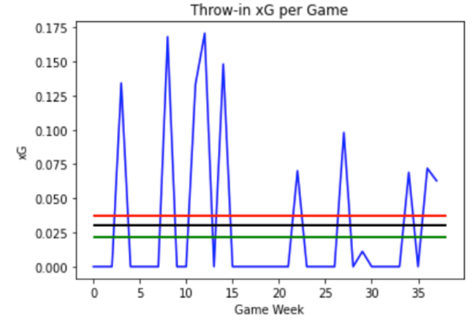
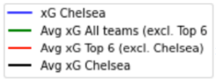
League Comparison of Expected Goals (xG) Generated from Set-Pieces
Notes:
As a first step in our analysis, we plotted the expected goal values per each set piece for chelsea.
Free-kicks leading to shot less became dangerous in the second half. Corners leading to shots were observed less frequently after the second half of the season but were dangerous.
Throw-ins nearly halved after the second half. Both in frequency and in volatility.
In contrast to other teams in the premier league, Chelsea, on average, outperformed the other teams in both Corners and Free-kicks.

Slide 14
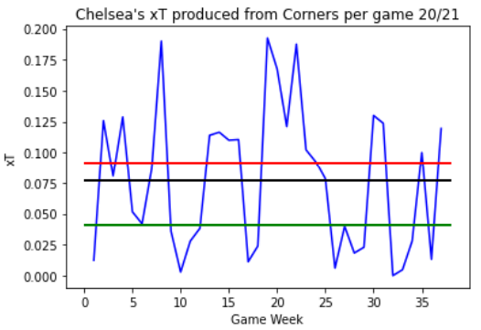
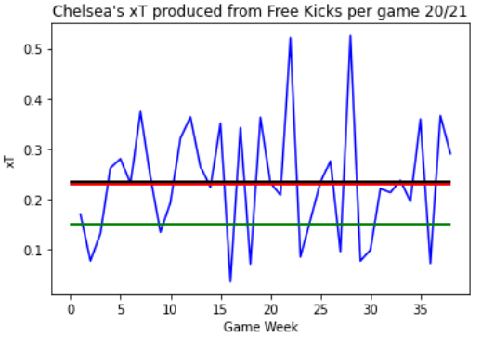
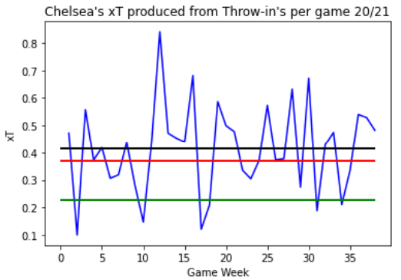
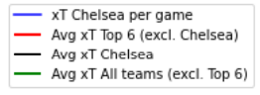
League Comparison of Expected Threat (xT) Generated From Set-pieces
Notes:
As a second step we decided to calculate Expected Threat for the generated chains starting from a set piece.
No clear indication of the team growing stronger/weaker during the management change was observed.
The team generally performs well with xT for Free Kicks and Throw in’s compared to most teams in the league.
They are underperforming for corners however the general xT sum generated from this is usually quite low anyways since a direct corner going straight into the box either results in a shot or clearance.

Slide 15
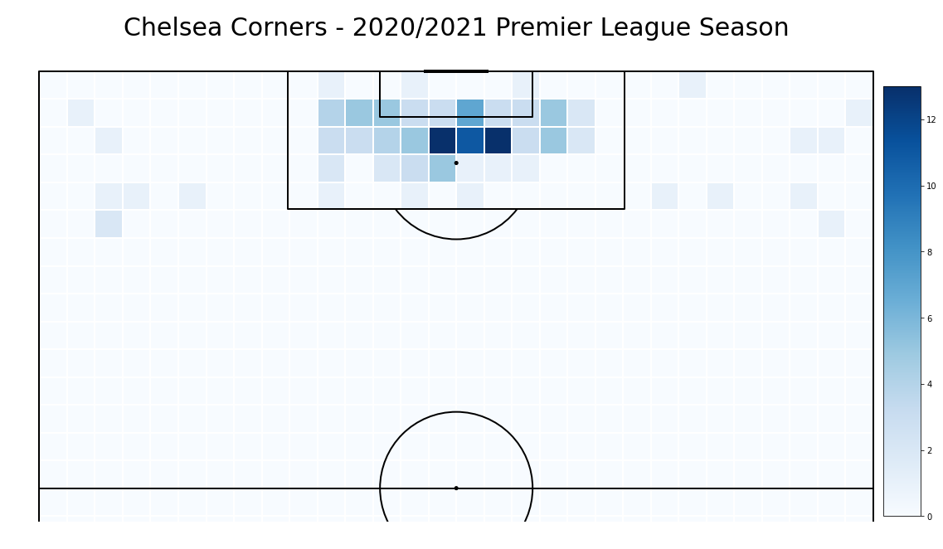
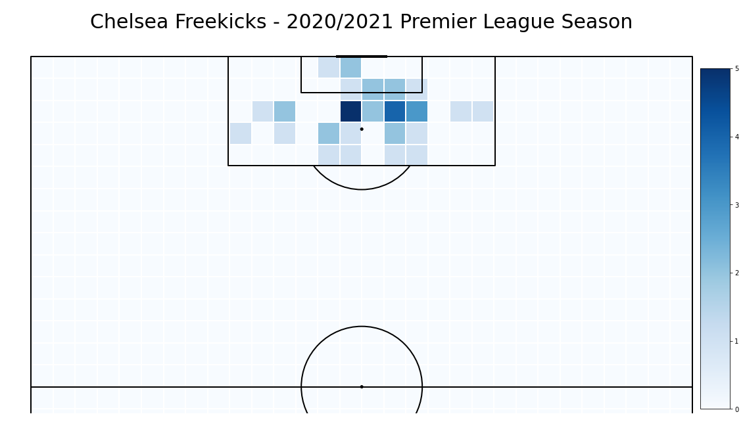
Heatmaps of Corners and Free-kicks for Chelsea
Notes:
We previously stated that Chelsea performed above average on Corner xG and Freekick xG.
The heatmaps with frequency as the metric, show that chelsea’s players at least try and place the ball into the most dangerous areas facing the goal, which in turn,
Can explain the high xG values we obtained.

Slide 16
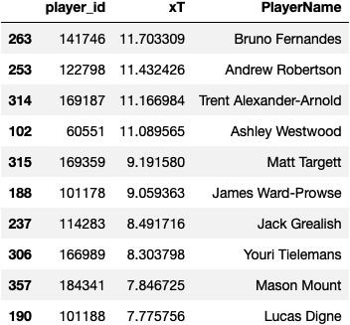
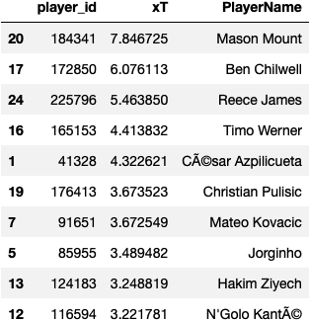
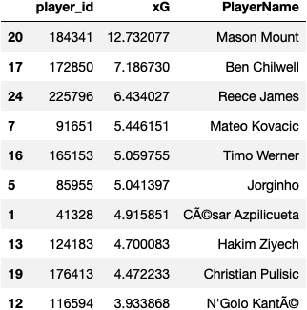
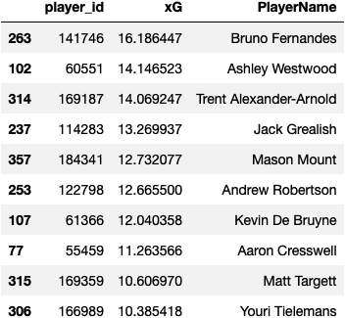
Player Rankings (xT / xG Chain) generated from Set-pieces
Expected Goal (xG) Chain
Expected Threat (xT)
Notes:
Lastly, we ranked Chelsea’s players based on both expected goal and threat, against all the players in the premier league.
Only one Chelsea player, namely Mason Mount makes it to the top 10 players with the highest threat values.
For set piece expected goal chain, Mason Mount is again the only chelsea player to make it into the top 10.
Within Chelsea, we can see the same three players topping the list for both xG and xT.
As these three players are the usual set pieces takers this is a feasible conclusion.

Slide 17
Project 3: Tracking Data
Scouting players to correct Chelsea’s weaknesses

Slide 18





Three Key Metrics for Consideration
Derived from the tracking data to assess player performance and determine suitable candidates for recruitment
Measuring direct play leading up to shot
Runs at high speed in the final third
Ratio of difficult shots on target
Through the identification of possession chains leading to shots.
Player speeds are calculated and offensive players in the final third are identified.
The shots that players are able to place on target from bad positions.
*All metrics are adjusted for minutes played.
Analysis conducted using SkillCorner Broadcast Tracking data and Opta Event data.

Slide 19

Metric 1: Measuring Direct Play Leading up to a Shot
Definition: A metric that identifies possession chains leading to shots. By pass value packing we identify how many defenders are defeated. Value of the packing is then adjusted for directness of play which is the amount of passes in the chain.
# | Player
1 | Steven Alzate
2 | Dennis Praet
3 | De Bruyne
4 | Connolly
5 | Phil Foden
6 | Ross Barkley
7 | Bernardo Silva
8 | Tyler Roberts
9 | Adam Lallana
10 | Neal Maupay
Advantages
Takes into account the amount of defenders defeated - the quality of shots
Identifies players heavily involved in possession leading to shots
Adjusts for the directness of possession
Disadvantages
The metric is weighted towards stronger teams and generally midfielders
Actions where ball is played further back the pitch will be lesser valued,
The quality of shots is more complicated than the metric can handle

Slide 20
Metric 2: Runs at High Speed in the Final Third
Definition: Player speeds are calculated and offensive players in the final third are identified. The amount of runs a player makes is summed for the whole season.
# | Player | Runs per 90
1 | Timo Werner | 2.17
2 | Sterling | 2.15
3 | Firmino | 2.06
4 | Matej Vydra | 2.0
5 | Edinson Cavani | 1.9
6 | Nathan Redmond | 1.85
7 | Jamie Vardy | 1.83
8 | Erik Lamela | 1.78
9 | Salah | 1.69
10 | Danny Ings | 1.68
Advantages
Identifies players with good physical capabilities in terms of speed.
Shows players that take initiative.
Players at a high level will make runs into space.
Disadvantages
Does not differentiate between bad runs and good runs.
Does not identify what other options the player had.
Weighted towards stronger teams.

Slide 21
Metric 3: Ratio of Difficult Shots on Target
Definition: The metric calculates the ratio of shots that players are able to place on target from bad positions. Bad positions are defined as shots at bad angles.
# | Player | Metric
1 | Ryan Fraser | 0.61
2 | Dennis Praet | 0.49
3 | Nathan Tella | 0.41
4 | Joe Bryan | 0.37
5 | Ayoze Pérez | 0.34
6 | Jordan Ayew | 0.33
7 | Ashley Barnes | 0.28
8 | Martial | 0.25
9 | Steven Alzate | 0.24
10 | Batshuayi | 0.23
Advantages
Identifies players able to get to shooting opportunities.
Adjusts for missed shots, thus finding players skilled at getting shots on target.
Players of strong teams likely to find themselves in better positions.
Does not account for how pressured the player is.
Disadvantages

Slide 22
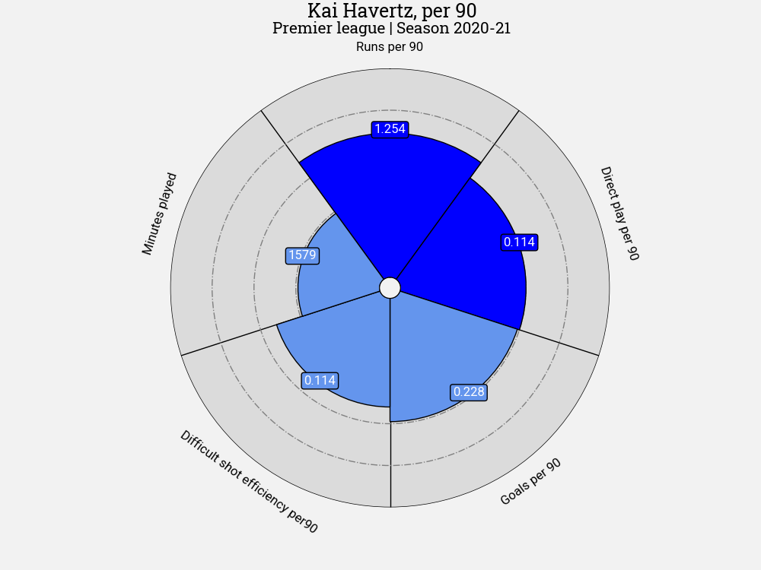
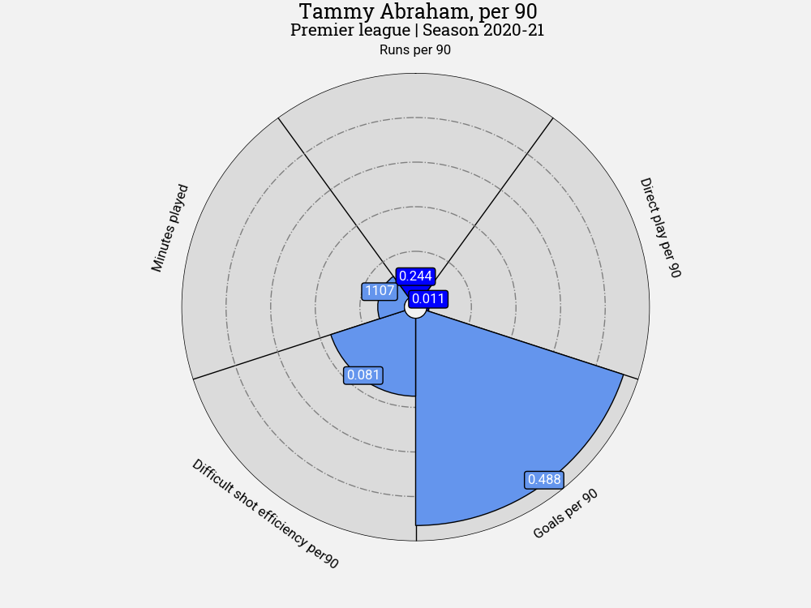
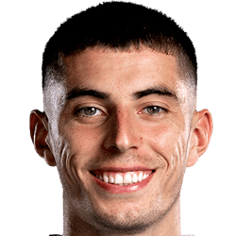

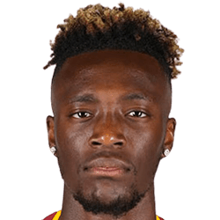


Identified Players in the Current Squad as Potential Areas to Upgrade
Based on the three derived metrics from the broadcast tracking data
Kai Havertz
Nationality
Age | 22
Position | Attacking Midfield
Market value | 70 m. €
Timo Werner
Nationality
Age | 25
Position | Centre- Forward
Market value | 65 m. €
Tammy Abraham
Nationality
Age | 24
Position | Centre- Forward
Market value | 38 m. €

Slide 23
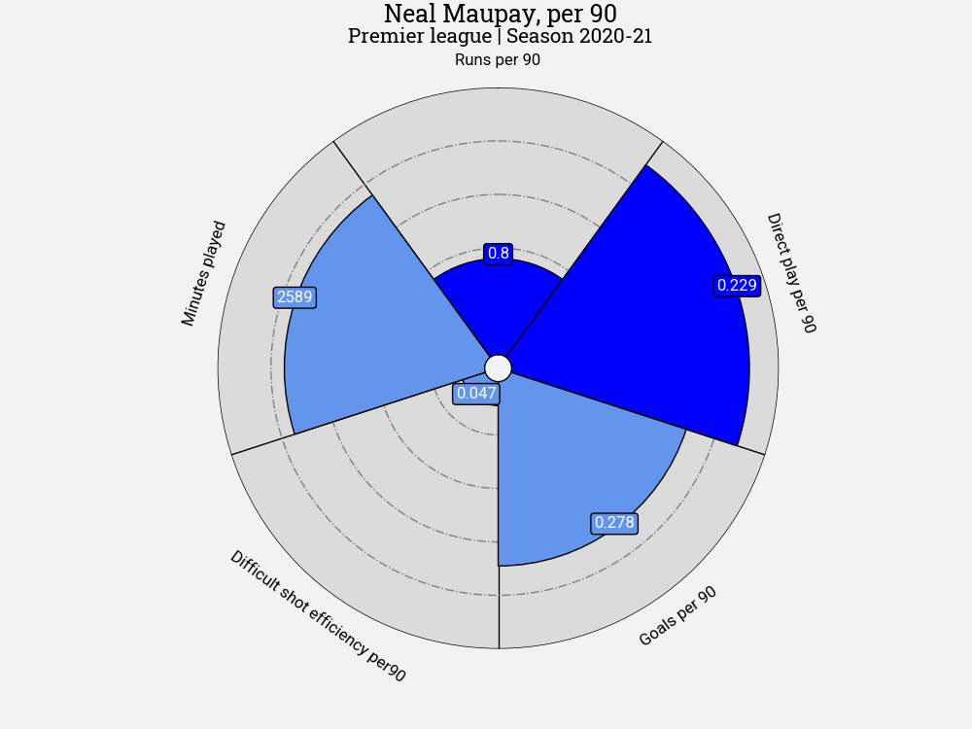
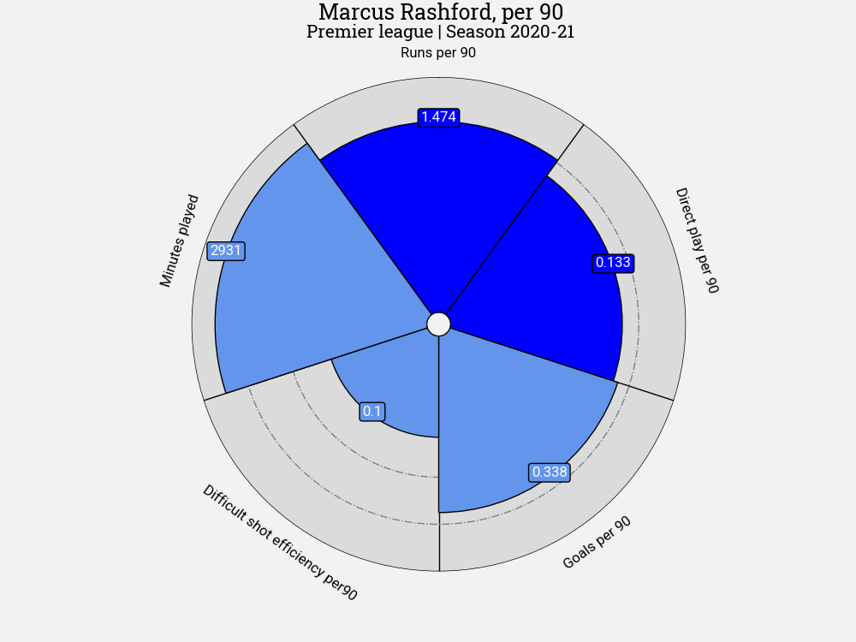
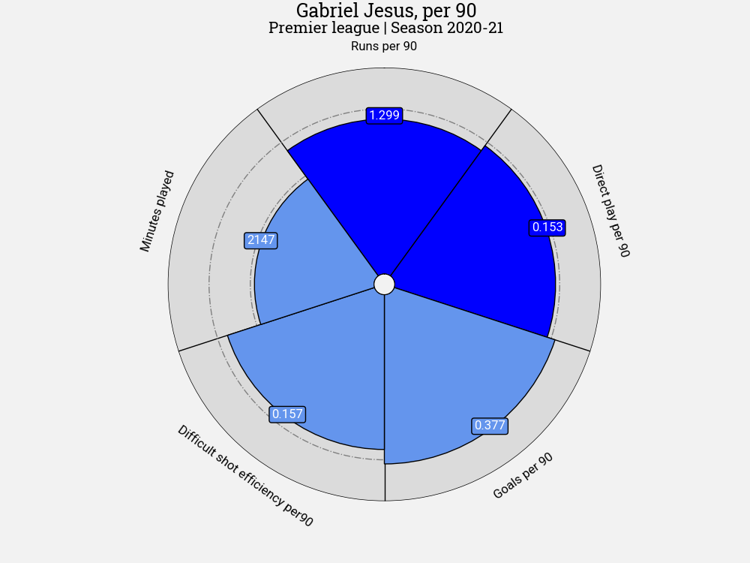

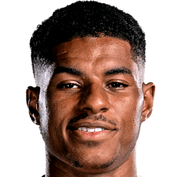
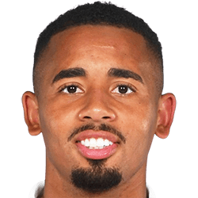





Shortlisted Players
Based on the three derived metrics from the broadcast tracking data
Neal Maupay
Nationality
Age | 25
Position | Centre- Forward
Market value | 20 m. €
Marcus Rashford
Nationality
Age | 24
Position | Left Winger
Market value | 85 m. €
Gabriel Jesus
Nationality
Age | 24
Position | Centre- Forward
Market value | 60 m. €

Slide 24
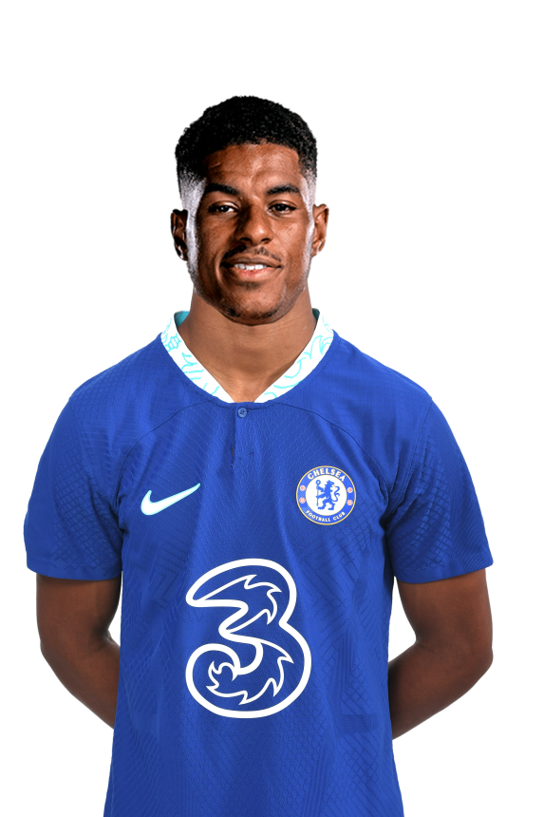
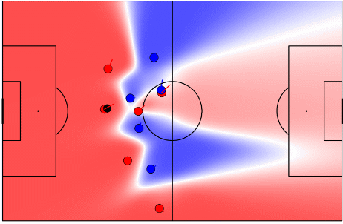
Marcus Rashford is Our Ideal Pick for Recruitment
The final recommendation of recruitment to improve Chelsea’s effectiveness going forward
Example of the use of Pitch Control, to demonstrate how Rashford is able to create space through his runs.

Slide 25
Conclusion

Slide 26
Conclusion of this Analysis
Data-driven insights determined
1
Identified the need to focus on offensive enhancements to the team based on club performance metrics. Simulations of alternative scenarios suggest signing an appropriate forward, thereby uplifting both quantity and quality of attempts on target, would be a key first step towards narrowing down the gap to Man City and Liverpool.
Determined that Chelsea are generally performing well within set pieces through the application of Expected Goals and Expected Threat, and are often managing to get the ball into dangerous areas. Ranked joint fifth highest in the league in amount of goals from set pieces (6, excluding penalties).
Application of Skill Corner Broadcast Tracking data to derive metrics for player scouting recommendations for Chelsea’s front line, measuring directness of play, high-speed runs into the final third and the ability to take difficult shots. The resulting analysis found Marcus Rashford to be the top recommendation.
2
3

Slide 27
References

Slide 28




References and Further Reading
Data Sources:
Football-data.co.uk recorded results data
Understat aggregated player and team performance data
Transfermarkt player bio and evaluation data
Opta Event data (Stats Perform)
SkillCorner Broadcast tracking data
Tutorials
How Our Club Soccer Predictions Work | FiveThirtyEight
Premier League Projections and New Expected Goals - Cartilage Free Captain
Friends of Tracking Tracking data tutorials by Laurie Shaw:
Part 1 – Introduction to analysing tracking data in Python: youtube.com/watch?v=8TrleFklEsE
Part 2 – Measuring the physical performance of players: youtube.com/watch?v=VX3T-4lB2o0
Part 3 – Advanced metrics: Pitch Control: youtube.com/watch?v=5X1cSehLg6s
Part 4 – Evaluating player actions and passing options: youtube.com/watch?v=KXSLKwADXKI
GitHub Repositories
LaurieOnTracking by Laurie Shaw for Tracking data implementation
Seminars and Videos
How Tracking Data is Used in Football and What are the Future Challenges with Javier Fernández, Sudarshan 'Suds' Gopaladesikan, Laurie Shaw, Will Spearman and David Sumpter for Friends of Tracking: youtube.com/watch?v=kHTq9cwdkGA.

Slide 29
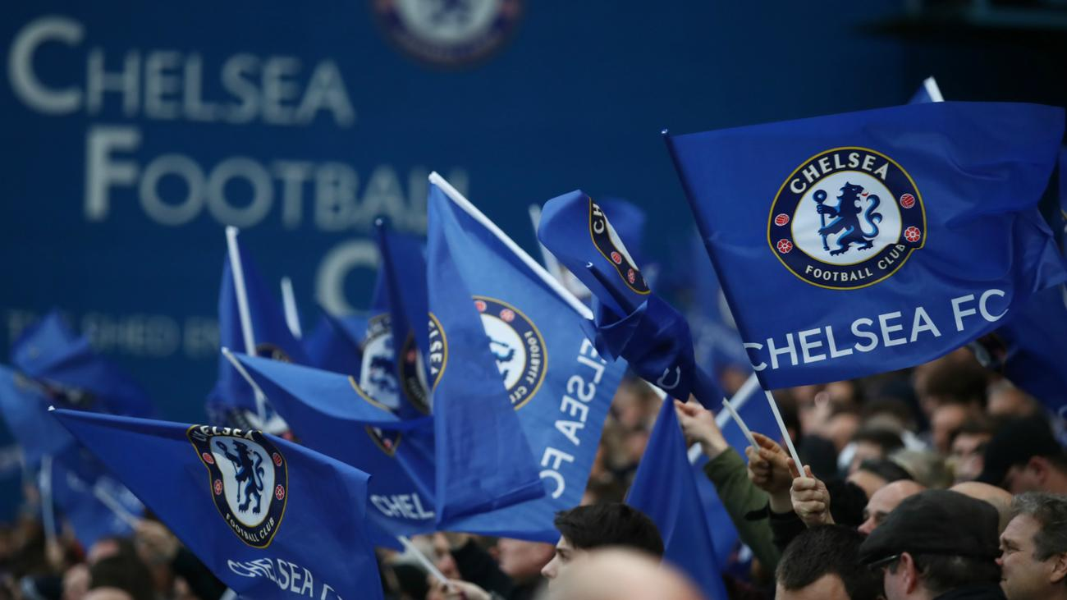
Thank You!

